Slide 1

Analysis of NYC FHVs and HVs Dataset
Team Members
Siva Venkata Chaitanya Nannapaneni(NANNA2S)
Ajay Adakula(ADAKU1A)
Kyathi Pasham(PASHA1K)

Slide 2

Introduction
The goal of this research is to evaluate the New York City FHVs and HVs dataset, which includes records of taxi journeys from the years 2014 to 2019. Each ride's pickup and drop-off locations, time, fare, and other ride-related details are provided in the dataset.
The goal of this project is to extract insights from the dataset to improve the efficiency, safety, and quality of taxi services in the city.

Slide 3

Data cleaning and dataset creation
The first step of the analysis would be clean the dataset if it have an irregular values.
Cleaned the dataset by removing any null or empty values that may exist.
Adding new columns like date, weekday, time of the day required for additional analysis.
Additionally, we will create a big dataset by combining records from each month. This will provide a more comprehensive and robust dataset for analysis.

Slide 4

Analysis on the following questions
1. Number of trips on each day of the week.
2. Average tips per trip per zone.
3. Tips throughout different times of day on each day of week.
4.Number of taxi rides of times on each day of the week.
5. Average tips per trip by pickup and dropoff zones.

Slide 5
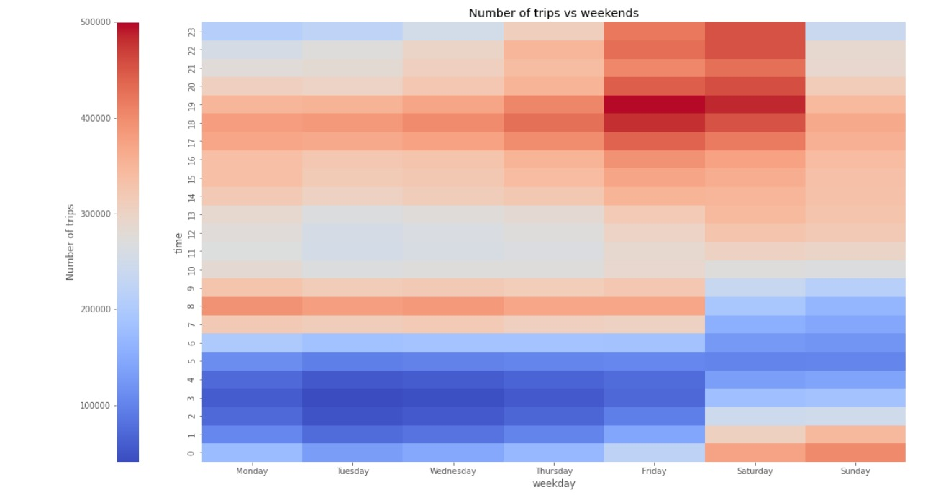
1. Number of trips on each day of the week
On Monday, As time progress, number of trips are increasing.
Highest number of trips are taken on Friday and Saturday Evenings.

Slide 6
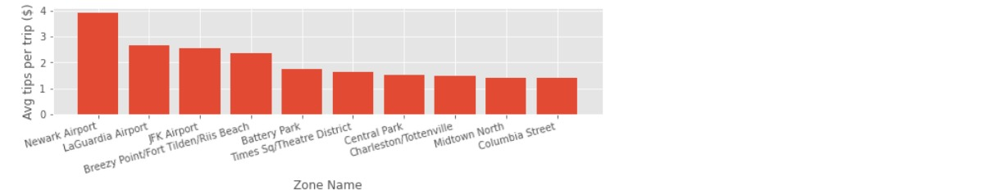
2. Average tips for trip per zone
1. Trips to Newark Airport, LaGuardia Airport and FK Airport has highest tips per trip.
2. Trips to residential areas like Columbia Street has lowest tips per trip.

Slide 7
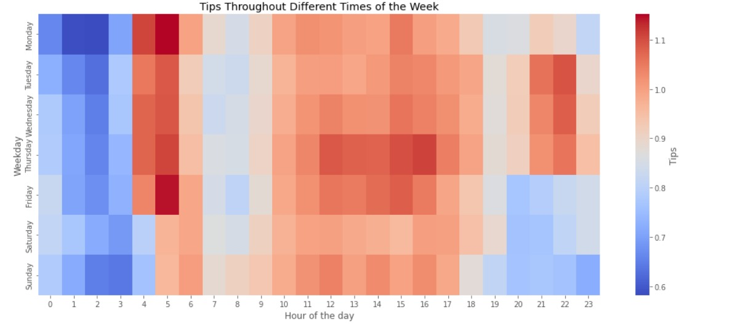
3. Tips throughout different times of day on each day of week
1. Most tips are calculated at early in the mornings and late at nights.
2. Even during mid days during office hours collected max tips.

Slide 8
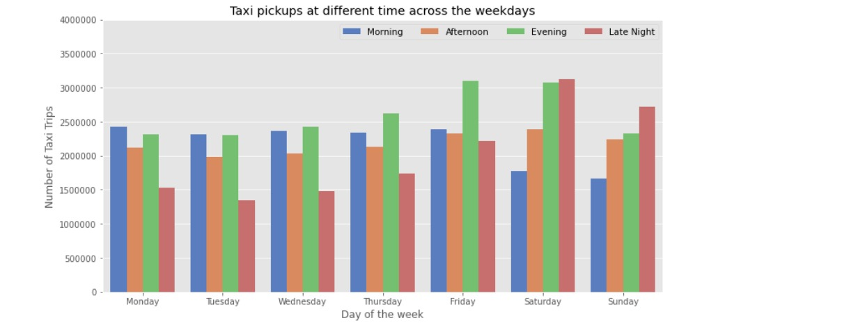
4.Number of taxi rides of times on each day of the week
1. Friday Evenings and Saturday Evenings have maximum taxi rides
2. Saturday and Sunday nights have next highest taxi rides.
3. Least number of trips are seen on Sunday Mornings.

Slide 9
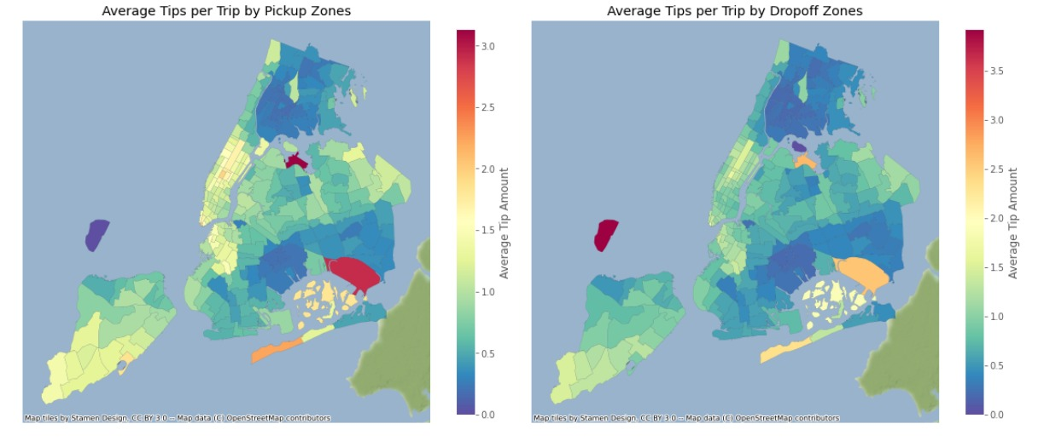
5.Average tips for trip by pickup and dropoff Zones
1. From the maps, staten island, have average tips given for both pickup and drop off zones.
2. Highest tips at pick up location is Queens.
3. Least tips are seen on Bronx

Slide 10

Conclusion
This project aims to analyze the NYC FHVs and HVs dataset to improve the efficiency, safety, and quality of taxi services in the city.
By analyzing the data, we can identify patterns and trends to optimize route selection, fare charges, and customer satisfaction. The analysis will provide valuable insights for the taxi service providers and policymakers to make data-driven decisions

Slide 11

Thank you

